Slide 1
Information Technology
School of Nursing

Slide 2
LHSON Technology
Randy Adams
Randy_Adams@baylor.edu
214-724-0675
Desrick Shelton
Desrick_Shelton@baylor.edu
214-577-5260
Trent Morelock
Trent_Morelock@baylor.edu
214-724-0404

Slide 3
LHSON Technology
IT Office – 4th floor
www.baylor.edu/nursing/techhelp (Request help)
Please include what days and times you are available
Appointments are appreciated if a certain window of time is necessary
Computer Repair/Troubleshooting - ☹
We will look at your machine and offer suggestions, but we are not a repair shop

Slide 4
Security
Bear ID
Passwords
Only the help desk can assist you with password issues
Baylor’s main help desk: 254-710-4357
You are required to change your password once a year
Changing password affects wireless access

Slide 5
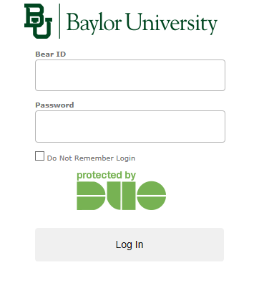
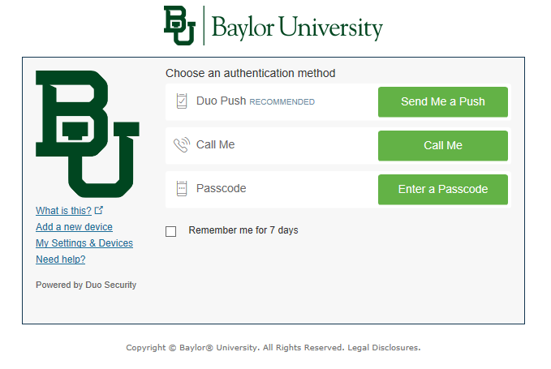
Security
DUO is our dual-authentication system – it will trigger when entering areas that require your Bear ID and password.
To set up Duo you will need to download the app to your mobile device – found in app store.
Go to baylor.edu/its/weduo – follow the instructions

Slide 6
LHSON Technology
AirBear – wireless access
AirBear is only available at LHSON… other places need to use their guest network if available.
How to…
Select “Airbear WPA2” from available wireless networks
Your computer should prompt you for a user name and password. Enter your Baylor user name and password.
If your computer wants to add a certificate, then accept it and ok anything it wants to do
4) http://www.baylor.edu/airbear

Slide 7
LHSON Technology
Printing
4 (2 color) in the hall leading to the Success Center
Legal size printing only on designated printer
1 on the outside of Activity Room
1 on 2nd floor of CSB (sim lab)

Slide 8
LHSON Technology
PawPrints – print release system
Each semester, users receive $28 of printing credit (good for 800 2-sided B&W prints).
Install on your laptop
2 Step Process
www.baylor.edu/pawprints
Special nursing driver www.baylor.edu/nursing/lrc
Always use PawPrints_Nursing as your printer choice to print.

Slide 9
LHSON Technology
Web Browsers – Have MULTIPLE browsers on your machine (Edge, Firefox, Chrome, Safari)
If one doesn’t work, then try another

Slide 10
LHSON Technology
Canvas – LMS
http://www.baylor.edu/canvas/
Spend some time becoming familiar with the layout and setting your notifications
Baylor Email:
http:\\mail.baylor.edu
Box – Network File Storage:
http://baylor.box.com

Slide 11
LHSON Technology
Webconferecing Tools
Microsoft Teams – join through Teams app, calendar invite, or Canvas
Zoom – join through Canvas or email invitation
General rules:
Mute your microphone when not in use
Turn off camera if you have lag
Use the phone in option if your internet goes down
Make use of chat in larger groups

Slide 12
LHSON Technology
ExamSoft – online exam
Will receive an email with login information and instructions ***Keep it
www.examsoft.com\baylornursing
Use Mozilla/Firefox or Chrome
Login and download
MAC OS 11.0, (Big Sur),12 (Monterey) and 13 (Ventura) only
WIN 10 and 11 only – not Win RT, Win 10 S, Win 11 S
WIN 10 22H2 and Windows 11 21H2, 22H2

Slide 13
LHSON Technology
ExamSoft – online exam
Load software well before the first exam
Take the practice exam!
Download exams ahead of time
Turn off/close all programs
Virus protection – may need to suspended or shut off
REBOOTING SOLVES MOST ISSUES

Slide 14
Services
Microsoft Office 365
Go to www.baylor.edu/its/office365
Or go to portal.office.com and use Baylor credentials
Evolve/Elsevier products
Outside vendor – our help is limited

Slide 15
Tech Tips
Download any needed items BEFORE coming to class. EXAMS!
Watch for times when printing bottlenecks and plan accordingly.
Check your Baylor e-mail frequently!
Be aware of what building you are in and how it is different from LHSON
Do you have 3 browsers? Get them!

Slide 16
Technology Web Pages
AirBear Setup and Support
http://www.baylor.edu/airbear
Technology Questions
http://www.baylor.edu/its
Help Request Forms
http://www.baylor.edu/nursing/techhelp

